Slide 1

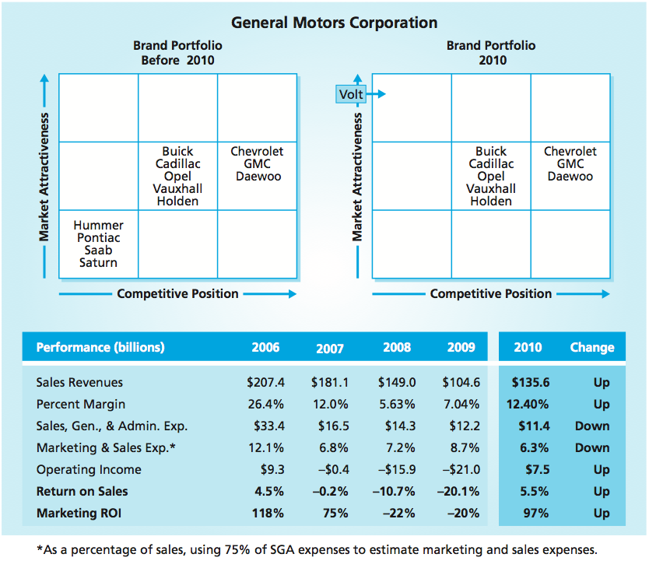
Defensive Strategies
MBM6
Chapter 13
Chapter 13
Defensive Strategic Market Plans
Protect Position
Optimize Position
Monetize, Harvest, Divest
Selecting A Defensive Strategy
■ The goal of defensive strategies is profit maximization, not sales or market share growth.
Copyright Roger J. Best, 2012

Slide 2
Defensive Strategies
MBM6
Chapter 13
Defensive Strategic Marketing Plans
In this section we will examine how defensive strategies are focused on maximizing short-run profits and protecting or improving long-term profits and the strategic position of a business.
Copyright Roger J. Best, 2012

Slide 3
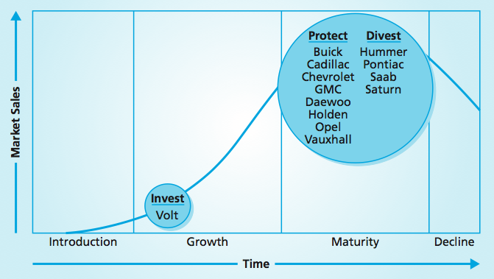
GM’s Strategic Market Plan
MBM6
Chapter 13
Perhaps the best example of a defensive strategic plan is General Motors’ complete restructuring of its brand portfolio in 2009.
GM discontinued or sold four major brands that could not meet its requirements for profitability and strategic growth.
Copyright Roger J. Best, 2012

Slide 4
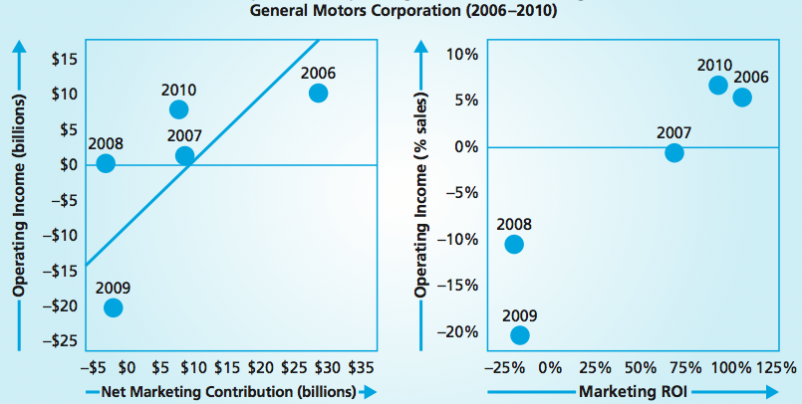
Operating Income and Marketing Profits
MBM6
Chapter 13
GM’s defensive strategy paid off in 2010. GM’s performance in 2010 produced a $31 billion gain in sales and increased the average margin from 7.04 percent in 2009 to 12.4 percent.
Copyright Roger J. Best, 2012

Slide 5
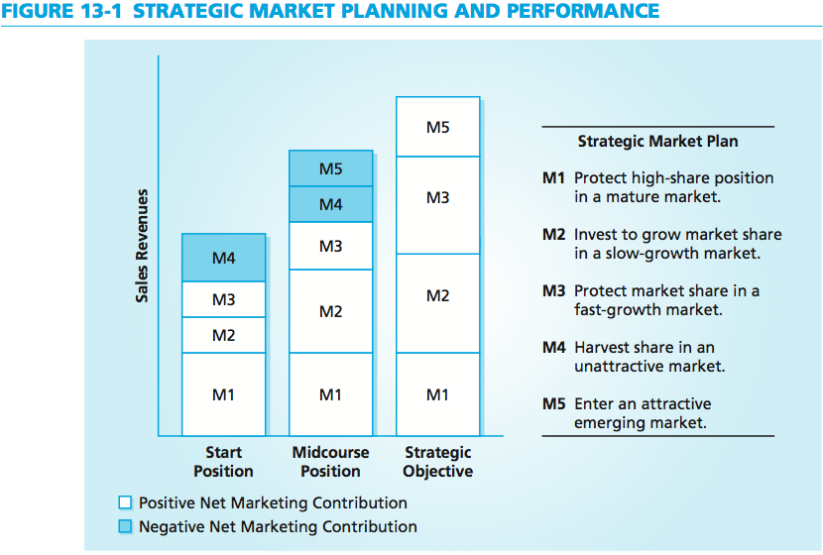
Strategic Market Planning
MBM6
Chapter 13
Each of these five market-based management strategies plays an important role in the business’s short- and long-run sales and profitability.
Copyright Roger J. Best, 2012

Slide 6
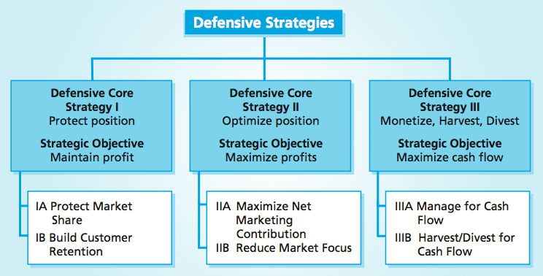
Marketing Performance Tools 13.1-13.3
Market Plans & Defensive Strategies
MBM6
Chapter 13
A defensive strategy is designed to protect profitability and key strategic share or to manage the profitability of a business that is moving beyond its potential for reasonable sales growth or profitability.
Copyright Roger J. Best, 2012

Slide 7
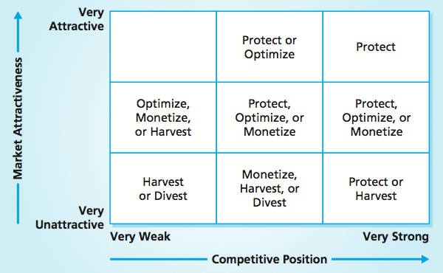
Portfolio Positions and Defensive Plans
MBM6
Chapter 13
Defensive strategies are focused on maximizing short-run profits and protecting or improving long-term profits and the strategic position of a business.
Copyright Roger J. Best, 2012

Slide 8
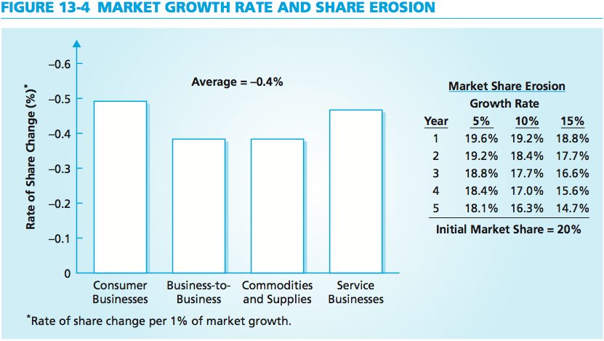
Market Growth & Share Erosion
MBM6
Chapter 13
The effects of market growth on market share change differ from industry to industry.
Copyright Roger J. Best, 2012

Slide 9
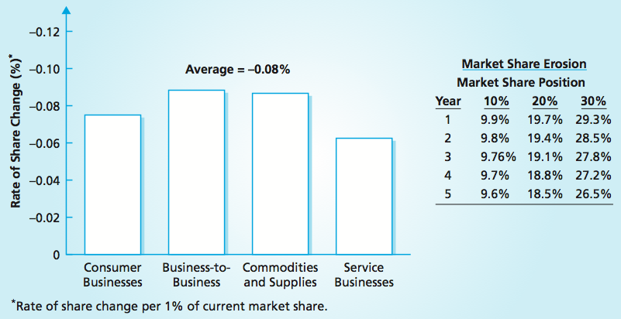
Share Erosion and Share Position
MBM6
Chapter 13
In the PIMS database we consistently find an inverse relationship between size of market share and change in market share.
Copyright Roger J. Best, 2012

Slide 10
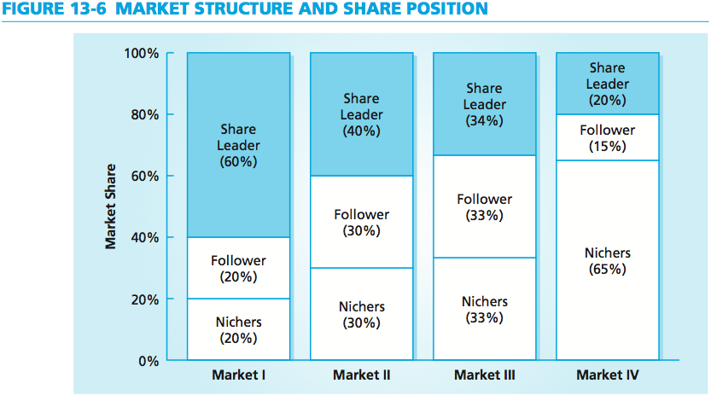
Market Structure and Share Position
MBM6
Chapter 13
Should the follower in Market II challenge the leader with an offensive share penetration strategy? Or should it protect its share position and maximize the profit?
Copyright Roger J. Best, 2012

Slide 11
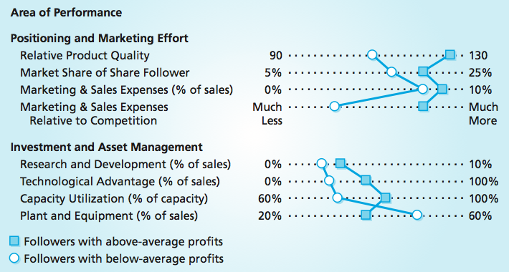
Share Follower Strategies
MBM6
Chapter 13
The more profitable followers protect their number-two share positions with investments in both R&D and marketing.
Copyright Roger J. Best, 2012

Slide 12
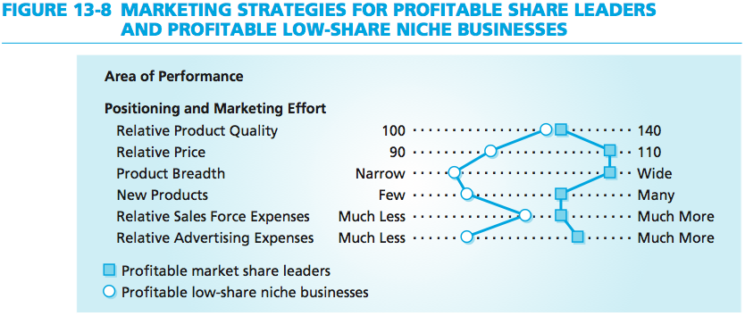
Share Leaders and Niche Businesses
MBM6
Chapter 13
In order to achieve above-average levels of profitability, low-share niche businesses need to focus on their products and keep their expenses low.
Copyright Roger J. Best, 2012

Slide 13
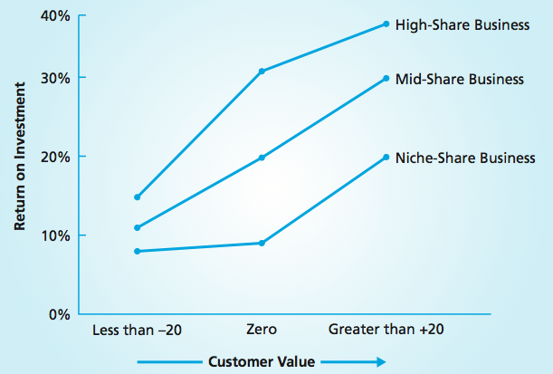
Customer Value, Market Share, & Profitability
MBM6
Chapter 13
A low-share business with above-average customer value is more profitable than a high-share business with below-average customer value.
Copyright Roger J. Best, 2012

Slide 14
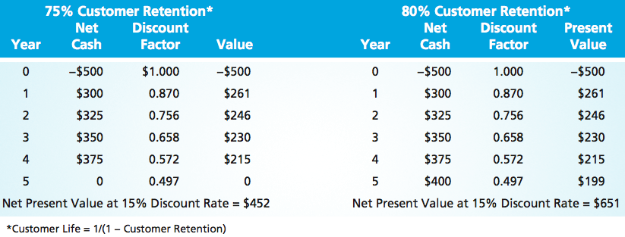
Customer Retention Strategy
MBM6
Chapter 13
A business that can build a higher level of customer retention can be more profitable than a business that maintains the same customer retention rate, even when both have the same market share.
Copyright Roger J. Best, 2012

Slide 15
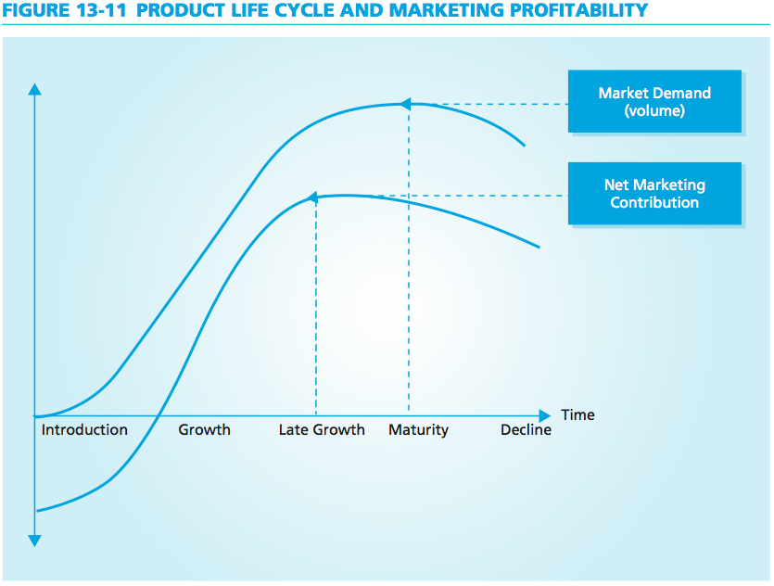
Product Life Cycle & Profitability
MBM6
Chapter 13
As volume produced by market demand nears its maximum potential and margins are not yet fully squeezed, a business can extract its highest level of gross profit.
Copyright Roger J. Best, 2012

Slide 16
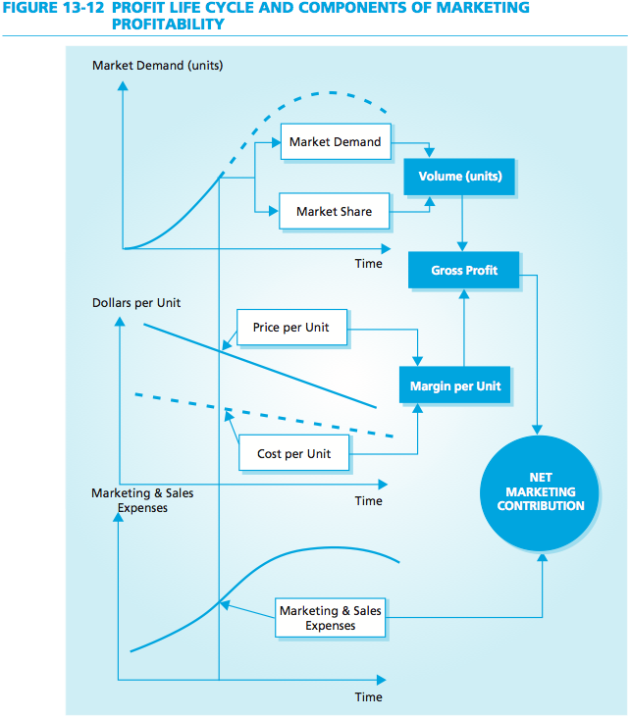
Profit Life Cycle and Profitability
MBM6
Chapter 13
Managed properly, this combination of volume, margin, and reduced marketing and sales expenses should yield maximum marketing profits over the product life cycle.
Copyright Roger J. Best, 2012

Slide 17
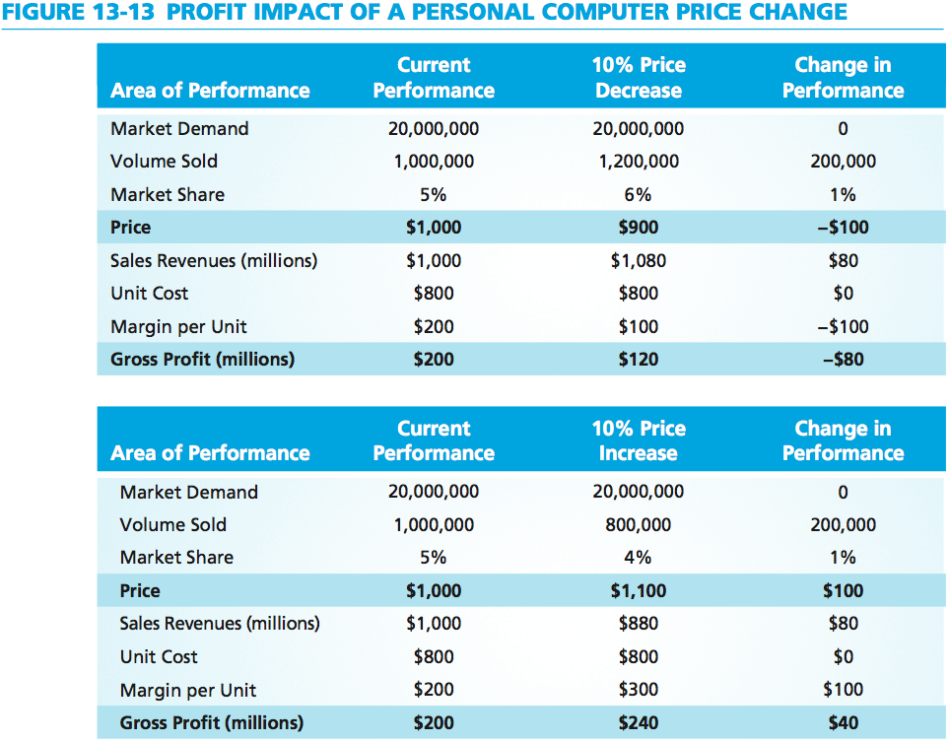
Price Impact of A Price Change
MBM6
Chapter 13
An optimizing strategy to raise prices by 10 percent in a maturing market would reduce volumes, market share, and sales, but would actually yield an $40 million increase in gross profit.
Copyright Roger J. Best, 2012

Slide 18
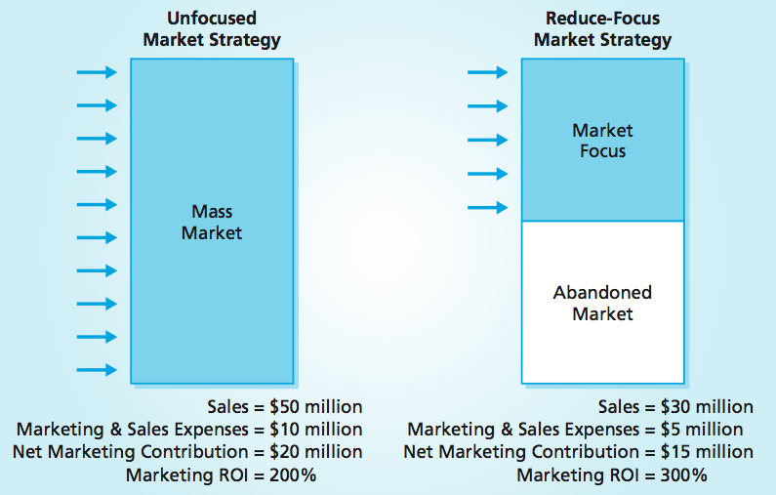
Selective Market Focus Strategy
MBM6
Chapter 13
The main purpose of a reduce-market-focus strategy is to become more efficient.
Copyright Roger J. Best, 2012

Slide 19
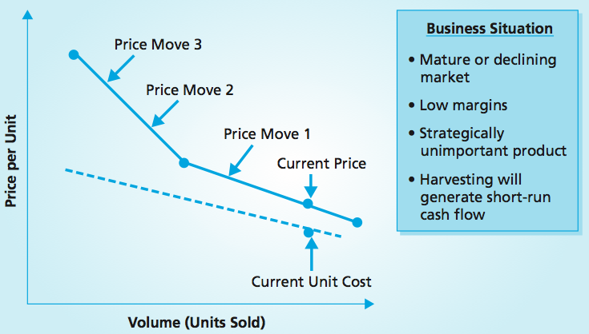
Harvest Price Strategy
MBM6
Chapter 13
A harvest price strategy continues to raise prices slowly with expected decreases in volume. This strategy often reveals a core of customers who would have paid more all along but, were glad to take the lower price.
Copyright Roger J. Best, 2012

Slide 20
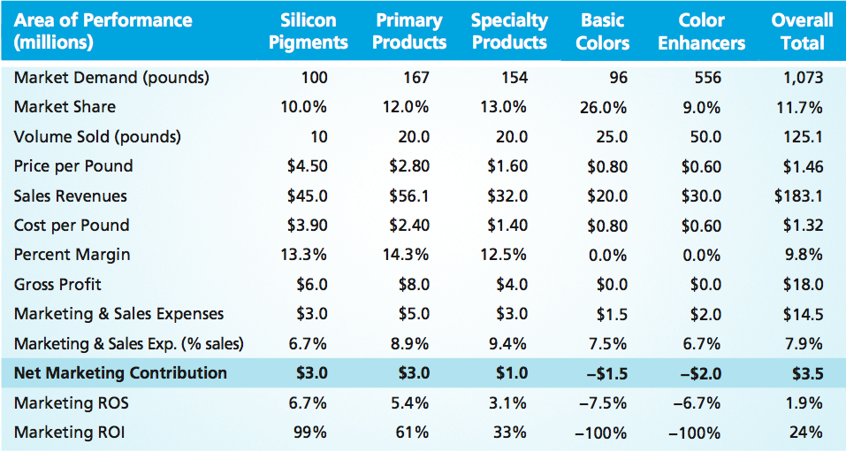
Product Line Performance
MBM6
Chapter 13
What should the management of this chemical company do in regards to the product lines that are not highly profitable or are producing marketing loses?
Copyright Roger J. Best, 2012

Slide 21
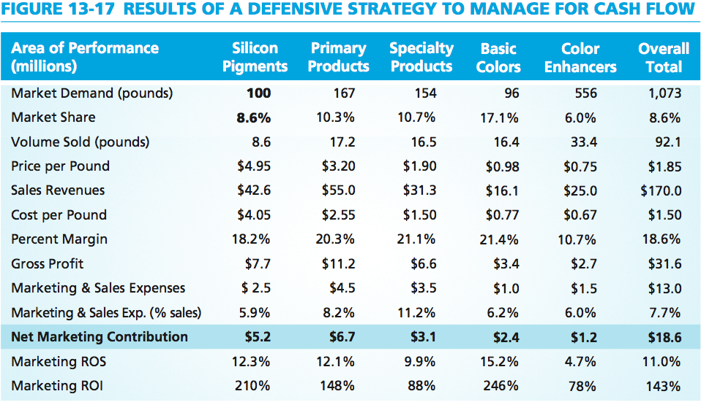
Defensive Strategy to Manage Cash Flow
MBM6
Chapter 13
The managers’ defensive strategy to reduce volume with higher prices and a lower marketing investment thus yielded a significant gain in profit.
Copyright Roger J. Best, 2012

Slide 22
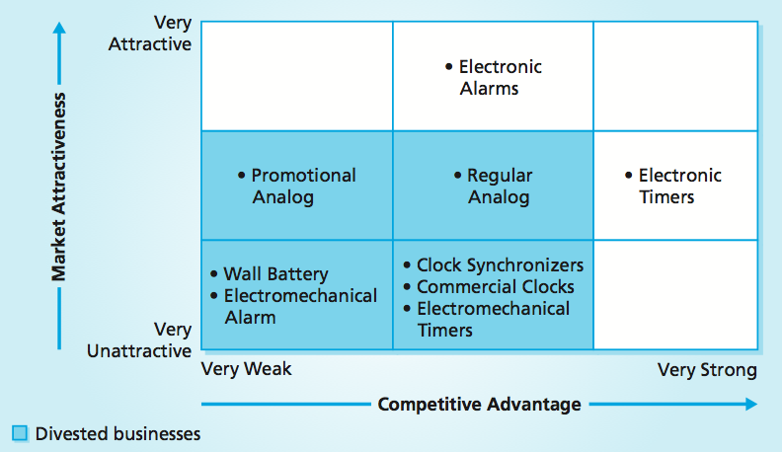
GE’s Divestment Strategy
MBM6
Chapter 13
In the late 1970s, many of GE’s products were in unattractive markets, had a weak competitive position, or both. What should GE have done in this situation?
Copyright Roger J. Best, 2012

Slide 23
Defensive Strategies
MBM6
Chapter 13
Selecting A Defensive Strategy
We will now consider a business that is making a positive net marketing contribution with an average competitive position in a market with below-average attractiveness.
Copyright Roger J. Best, 2012

Slide 24
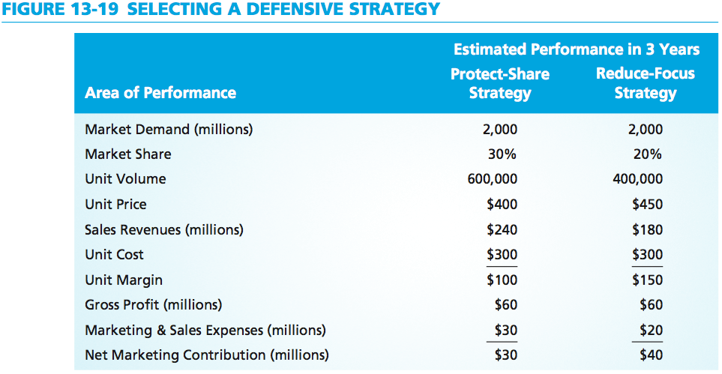
Selecting a Defensive Strategy
MBM6
Chapter 13
Which defensive strategy should this business pursue? And why?
Copyright Roger J. Best, 2012

